Slide 1
Grainger Renewals Journey
There’s always a better way

Slide 2

Overview
Grainger Renewals Project
Grainger plc have engaged with Open Box to redesign the existing Renewals Journey in their Salesforce org.
​​The renewals process is currently shoehorned into the Salesforce leasing journey which is designed primarily for new leases. Many key inputs for this process are held out of system (including price book rent in spreadsheets) or in other systems (such as arrears balances in Qube), requiring considerable manual effort to cross-check information between systems and key into offline spreadsheets that are circulated between teams. Limitations with the existing portal in which tenants review renewal offers, result in tenants being regularly unable to access the portal.
The likely introduction of the Renters’ Rights Bill in 2025 must additionally be considered as this will have a notable impact on the renewal process for the majority of Grainger’s tenants.

Slide 3
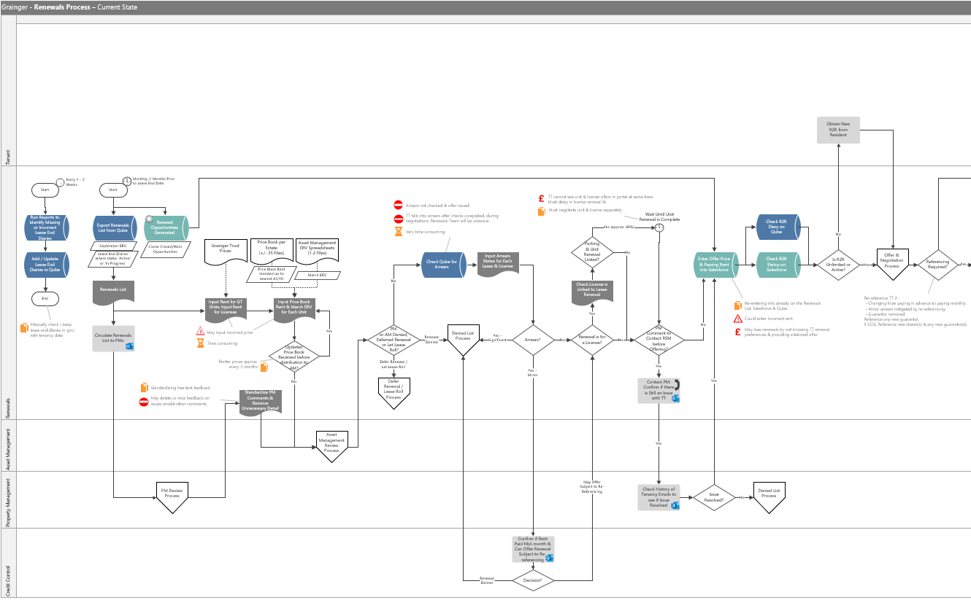
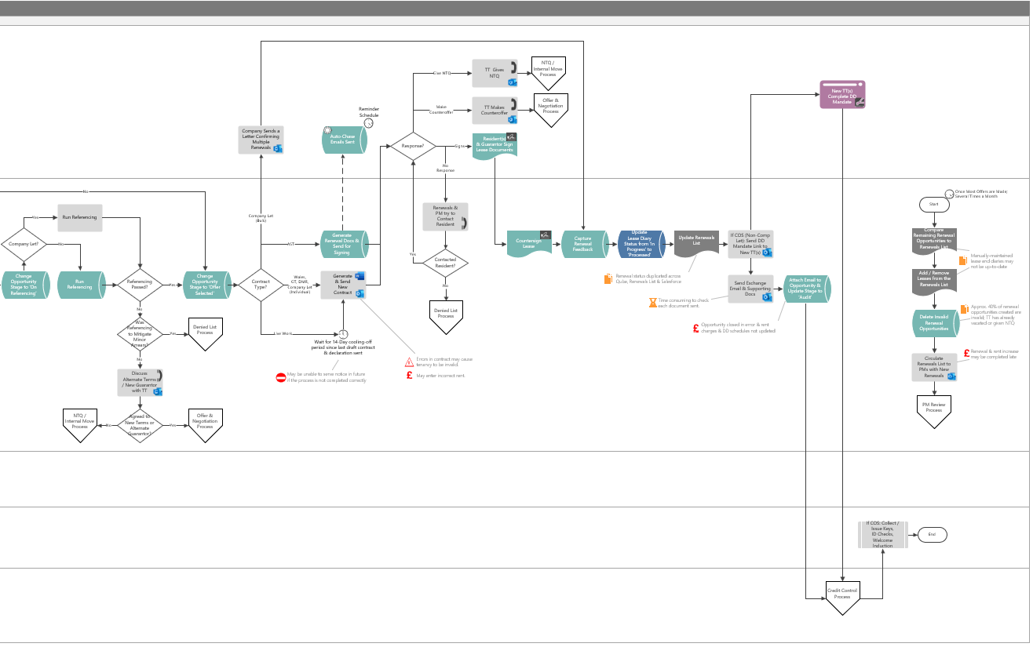
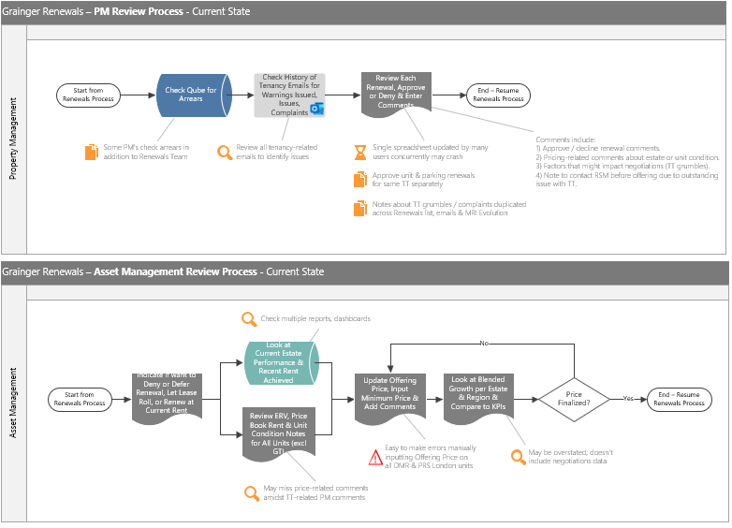
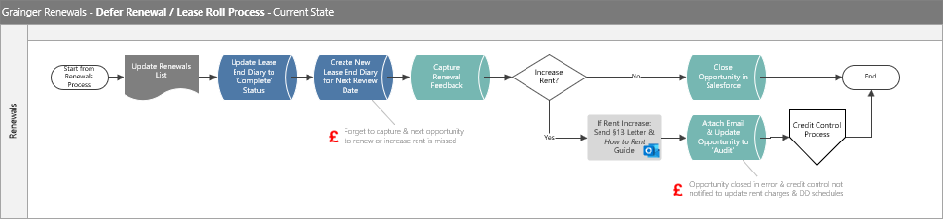
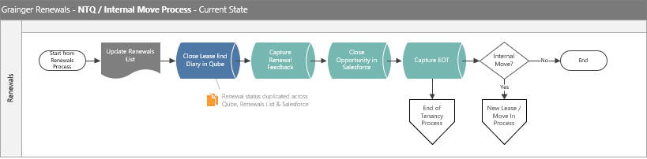
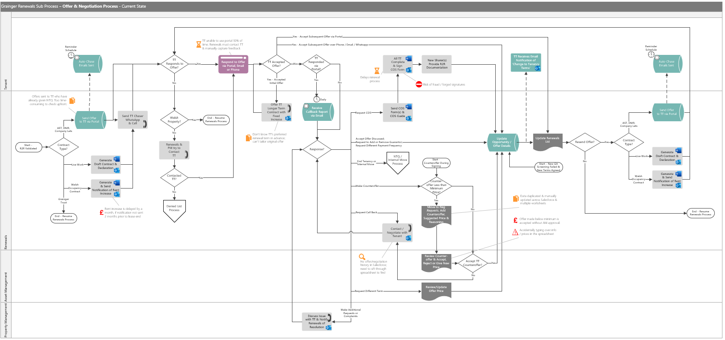
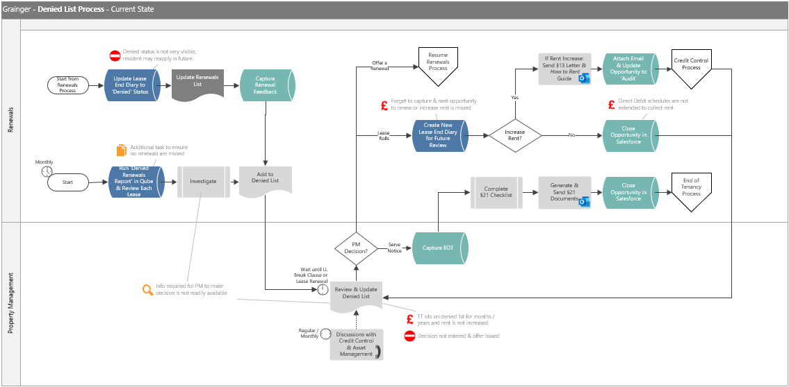
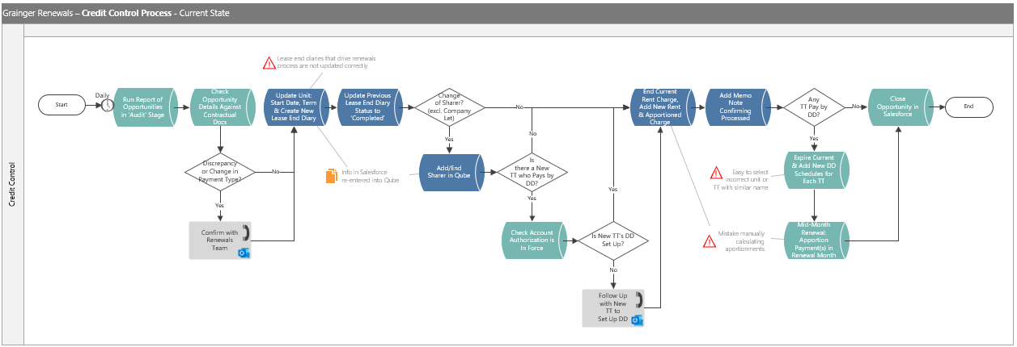
Current State Process Flow
Significant Inefficiencies, Risks & Off-System Processes

Slide 4
Current State Process Flow
Significant Inefficiencies, Risks & Off-System Processes

Slide 5

Current Risks & Challenges
Risk of Monetary Loss
Time-Consuming Tasks
Risk of Errors from Significant Manual Data Entry
NTQ received late.
Lease end diary not captured.
Delayed rent increases for Wales must wait a further month.
Tenant sits on denied list for years & rent is not increased.
Duplicate data entry across Qube, spreadsheets and Salesforce.
40% of renewal opportunities created in Salesforce are incorrect.
Tenants unable to use portal 50% of the time & contact staff directly.
Inputting incorrect prices.
Accidentally overwriting or deleting information on the spreadsheet
Risk of Renewing Tenancies that should be Denied
Lack of Visibility & Easily Accessible Information
Limited Controls
Tenant falls into arrears after checks.
Renewals not aware of decision to serve notice.
PM comments are deleted in error when unstructured feedback is cleaned-up.
Arrears checks are missed in error.
AM approval for offers below minimum price is skipped in error.
No history of offers, counteroffers and tenant responses hinders negotiations and decision-making.
Current Challenges with the Renewals Process:
Risk of Errors from Significant Manual Data Entry
Duplicate Data Entry across Salesforce, Qube & Spreadsheets
Lack of Visibility Hinders Decision-Making
Risk of Renewing Tenancies that Should be Denied
Delayed Renewals Result in Monetary Loss
Time-Consuming Tasks

Slide 6

Vision & Objectives
Project Vision :
Replace the existing tenant portal for renewal offers as well as the offline renewal spreadsheets with an enhanced Salesforce Renewals Journey that minimises manual data entry, removes the need to cross-check information between Salesforce and Qube, and delivers functionality that will remain relevant once the Renters’ Rights Bill is enacted.
Key Objectives :
Eliminate Manual Entry of Price Book Rent & ERVs
Visibility into Tenancy Arrears in Salesforce
Maintain Offer & Counteroffer History
Automate Notifications, Highlight Delays & Blockers
Create Renewal Opportunities from Accurate Tenancy Data
Replace Offline Renewals Spreadsheet

Slide 7
Business Benefit
Redesigning the Renewals Journey will help to:
Improve speed & efficiency of the process.
Allow business to scale operations without necessitating a linear increase in headcount.
Obtain notice to quit from tenants earlier in the process, minimising void days.
Obtain renewal preferences from tenants upfront, allowing for renewal offers to be tailored.
Minimise back-and-forth between tenants and renewals negotiators.
Build the foundation for a single view of tenancy within Salesforce.
Improve the tenant experience with a reliable online interface.
Highlight renewals approaching deadlines to avoid delayed rent increases.
Reduce offline communications between teams.
Provide a single source of truth for renewal information.
Minimise errors.

Slide 8
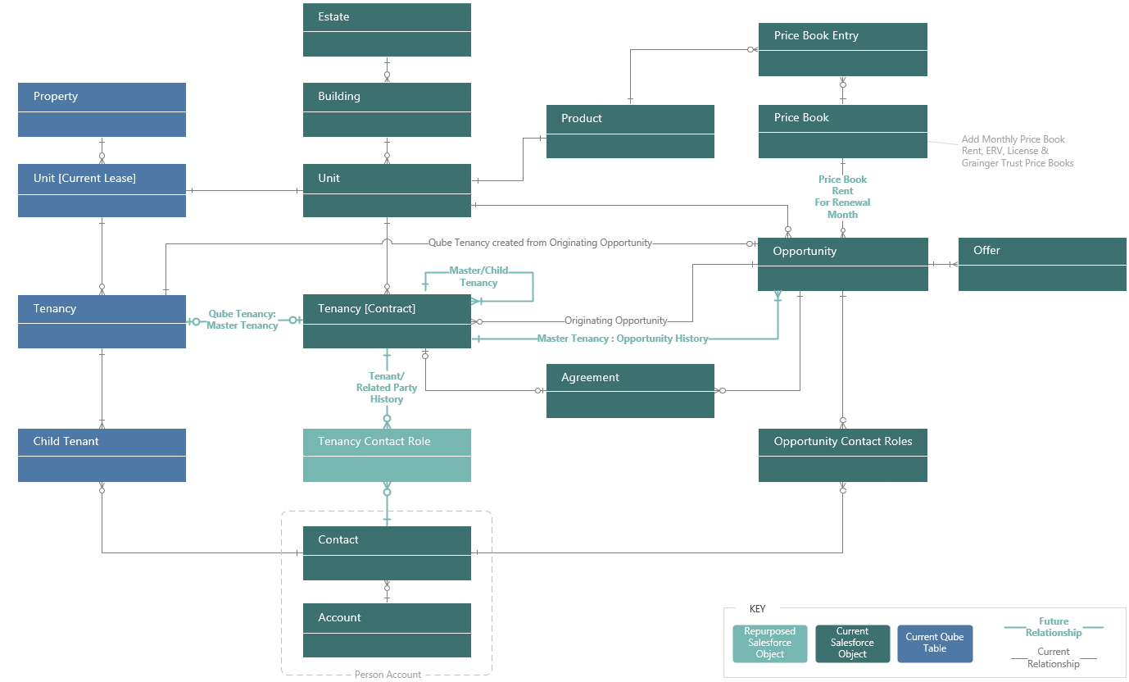
Solution Features – Release 1
Create Foundation for a Single View of Tenancy
Align Qube & Salesforce Tenancy Data Model
Notes:
Align Salesforce & Qube Tenancy Data Model – Create a master tenancy in Salesforce that maps to the Qube tenancy and provides a single view of tenants/related parties, opportunity and tenancy version history.

Slide 9
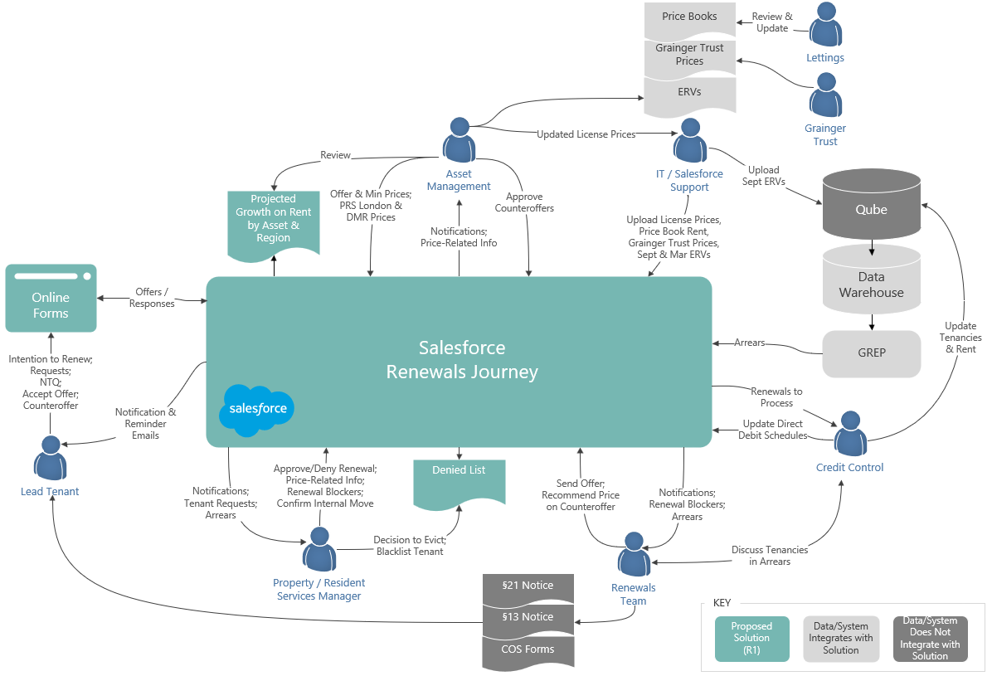
Solution Features – Release 1
Prepopulate Inputs to the Renewals Process
See Current
Tenancy Arrears in Salesforce
Upload ERVs, Price Book Rent, Grainger Trust & License Prices
Deny a Renewal
Mid-Term &
Manage Denied List
Manage Unit Condition & Estate Pricing Factors
See Projected
Growth on Rent
by Asset & Region
Manage Tenant
Requests at Renewal &
Renewal Blockers
Notes:
See Current Tenancy Arrears in Salesforce – Import the current tenancy arrears balance from the data warehouse and view as part of tenancy and renewal information.
Upload ERVs, Price Book Rent, Grainger Trust & License Prices into Salesforce – Enable support users to upload spreadsheets containing Price Book Rent, Grainger Trust prices, ERVs and license prices into Salesforce as and when updated.
Deny a Renewal Mid-Term & Manage Denied List – Provide ability to deny a renewal mid-term, track whether the decision to serve notice has been made, blacklist tenants and monitor tenancies on the denied list.
Manage Unit Condition & Estate Pricing Factors – Enable PMs/RSMs to maintain unit condition and block-level pricing factors in Salesforce which Asset Managers can see when reviewing renewal pricing.
See Projected Growth on Rent – Provide a dashboard for Asset Managers to see growth on rent by asset and region, based on projected renewal prices.
Manage Tenant Requests at Renewal & Renewal Blockers – Allow PMs to indicate where Renewals must hold off on offering, notify PMs/RSMs where a tenant makes a request during the renewal process, and enable the Renewals Negotiator to see when these requests and blockers are resolved as well as the outcome.

Slide 10
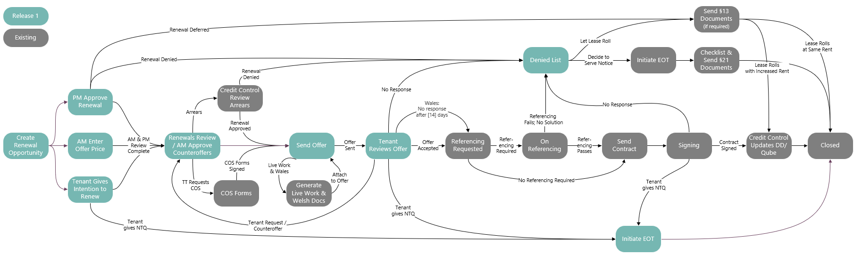
Solution Features – Release 1
Replace Spreadsheet & Tenant Portal within the Current Renewals Journey
Automatically Create Renewal Opportunities from Accurate Tenancy Data
Enable Tenant to give
Early Intention to
Vacate or Renew
PMs Approve, Deny, or Defer Renewals
AM Update
Offer & Minimum Prices
Renewals Team Review & Send Prepopulated Offers; See Full Offer History
Tenants Receive, Respond to Offer(s) & Counteroffer Online
AM Approve Counteroffers
Initiate EOT when
Tenant gives NTQ or
for Internal Move

Slide 11
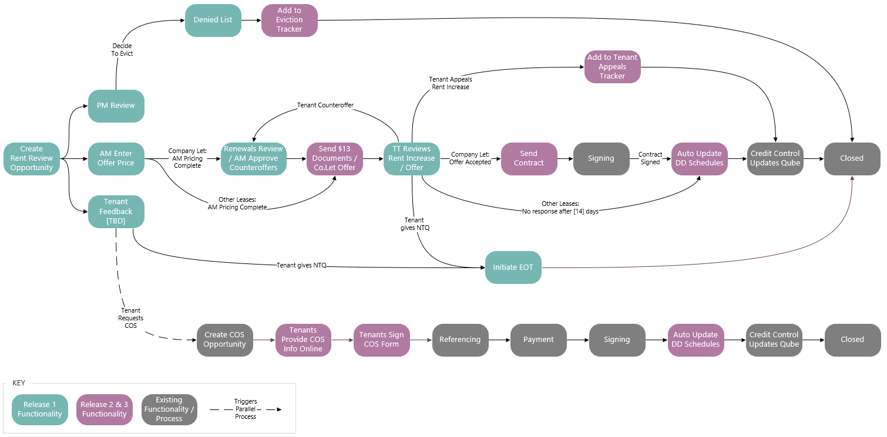
Solution Vision - Post-Renters’ Rights Bill
Build on the Enhanced Renewals Journey

Slide 12
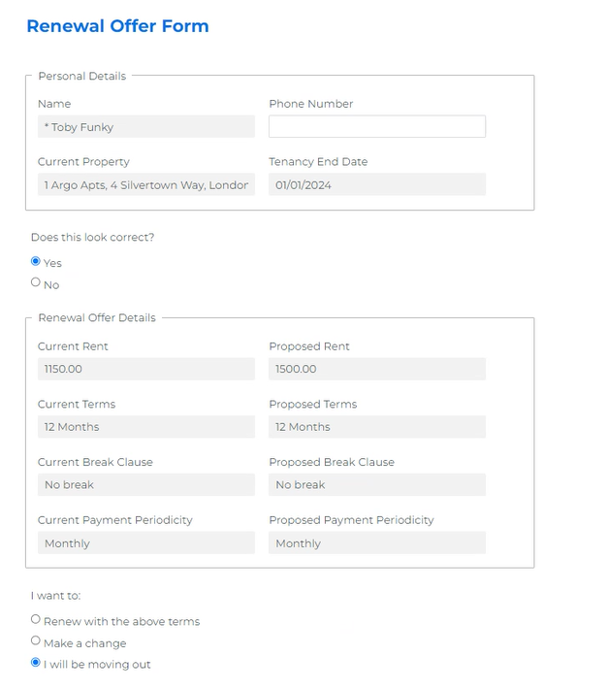
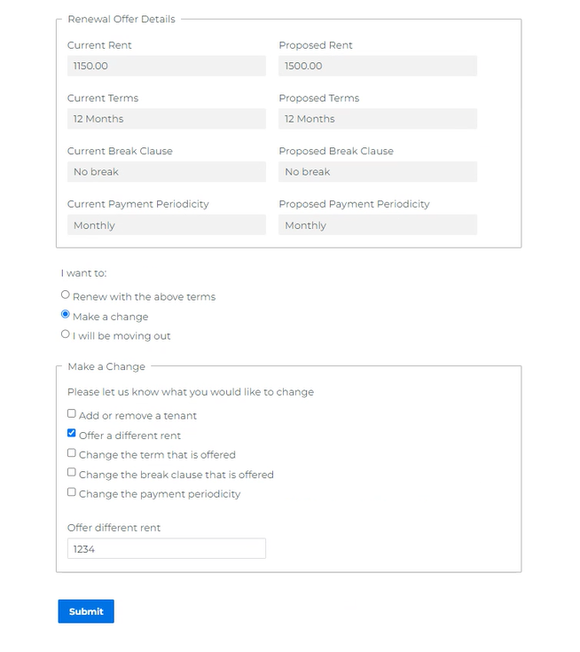
Proof of Concept
Tenant Provides Renewal Intention or Responds to Offer via Form Assembly
Dynamic form prompts tenant for more information depending on response(s) selected
Tenant clicks on link in a system-generated email to open a form
Opportunity & offer information is sourced
real-time
Reponses are saved on the opportunity, offer or creates new records

Slide 13
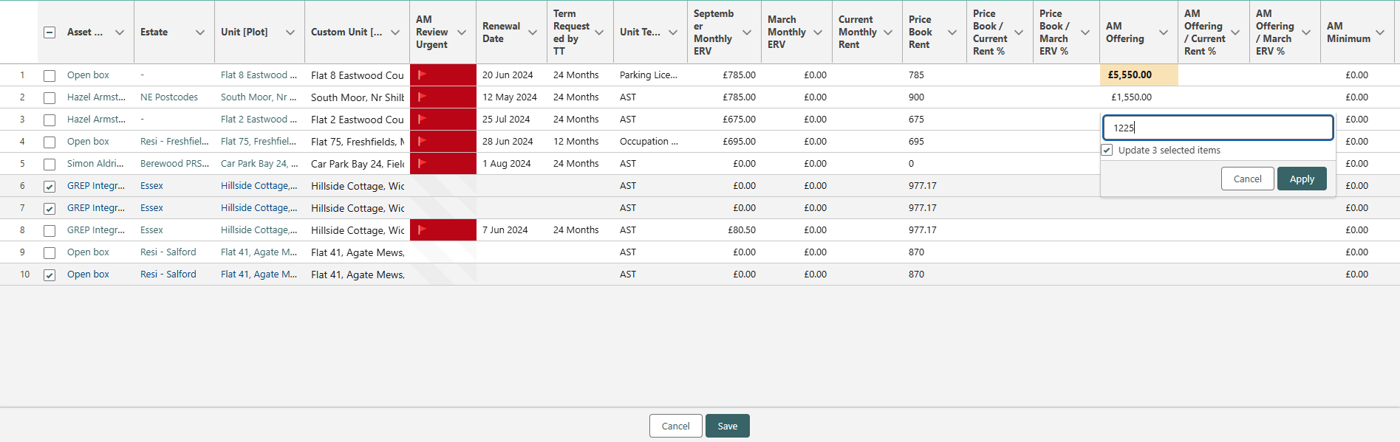
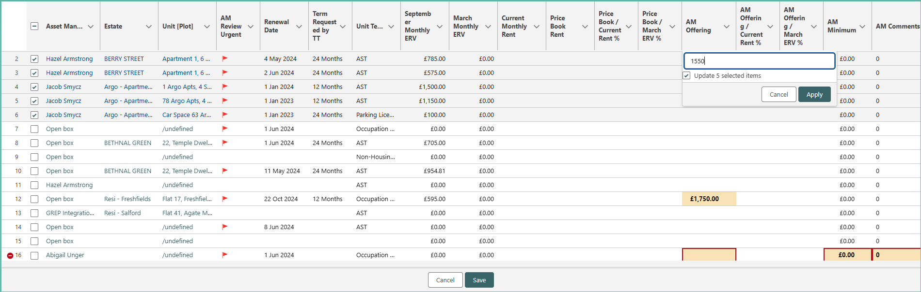
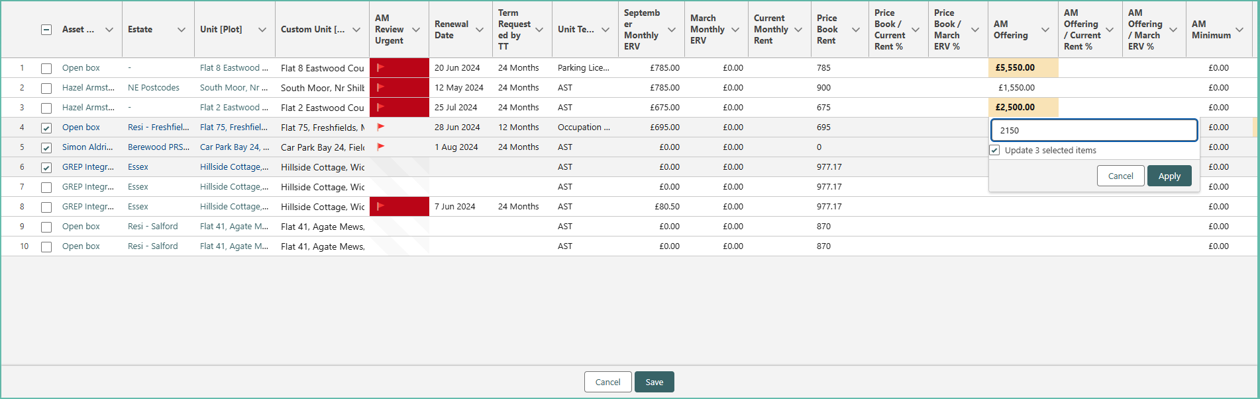
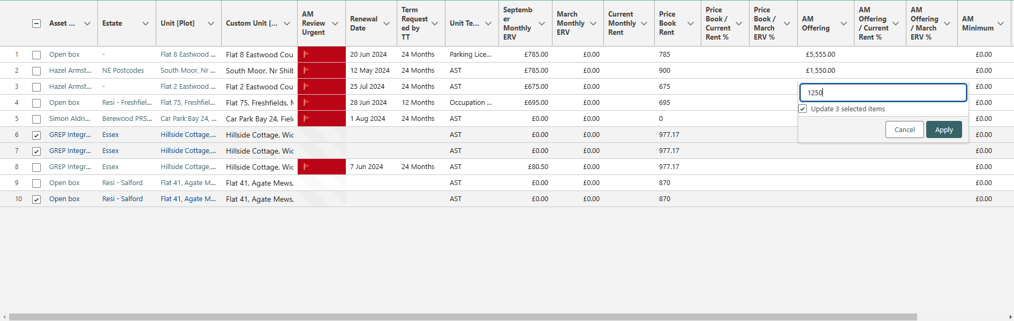
Proof of Concept
Replace Renewals Spreadsheet with LWC Data Tables Relevant for each Team
Users can make bulk updates
Conditional Formatting
Additional functionality available:
Filters
Calculated fields
Action buttons
View information in hover-over
Information can be sourced from related objects e.g., latest price book rent for the renewal month
Values that fail validation are highlighted

Slide 14
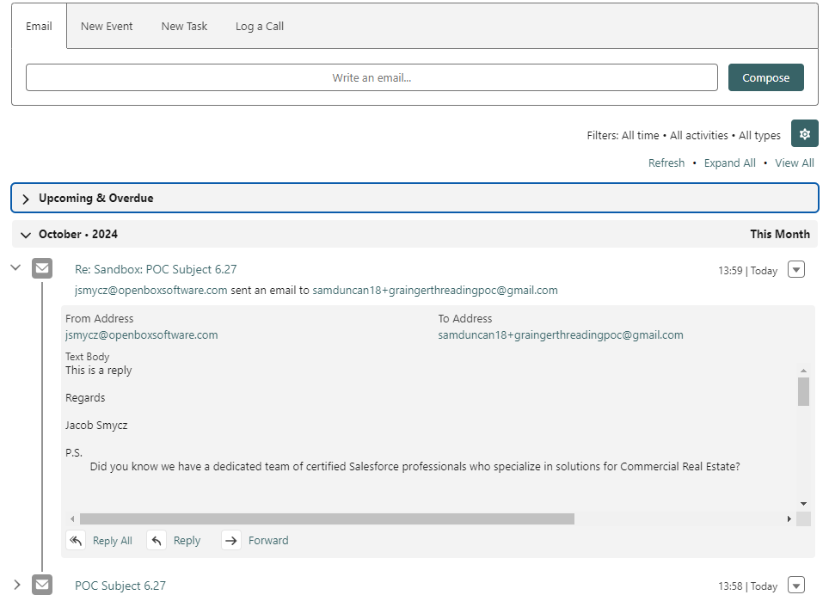
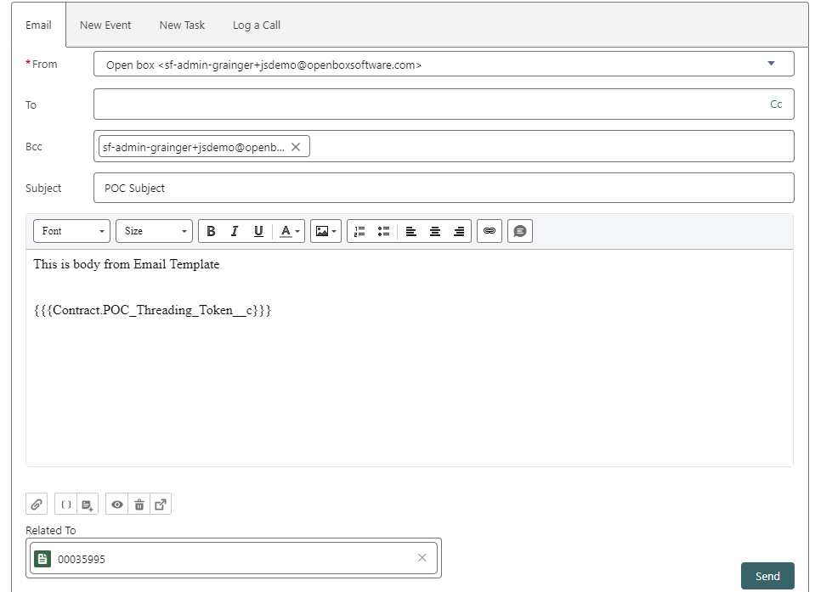
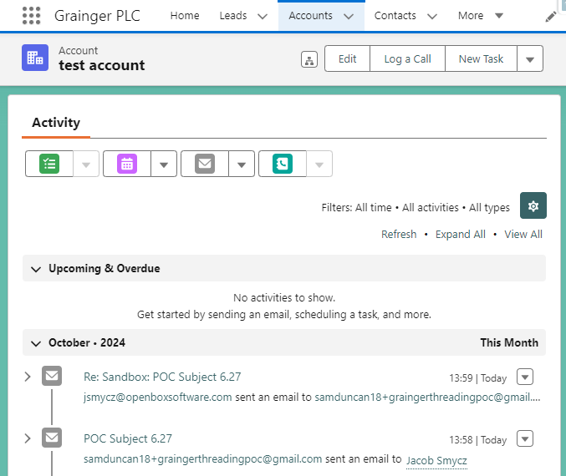
Proof of Concept – TBD if required
Email Threading onto an Opportunity
User sends an ad hoc email to the tenant from an opportunity, selecting an email template that includes a threading token
Email response is displayed on the opportunity
Email response
is also displayed on the tenant (person account)

Slide 15
Proposed Roadmap
Release 1
Release 2
Post Renters’ Rights Bill
Release 3 Future
Denied List
Tenant Gives Early Intention to Renew
PMs Approve, Deny, Defer Renewals
Tenant Renewal Requests & Blockers
View Unit Condition & Estate Pricing Factors
Upload ERVs, Price Book Rent, Grainger Trust & License Prices
AM Update Offer & Minimum Price
Projected Growth on Rent Dashboard
View Tenancy Arrears
Tenants Respond to Offers Online
AM Approve Counteroffers
Initiate EOT at NTQ or Internal Move
Align Qube & SF Tenancy Data Model
Generate §13 Notification of Rent Increase
Rent Appeals Tracker
Eviction Tracker
Customise Renewals for Wales, Company Lets, Live/Work, DMR & Grainger Trust
AM Dashboard: Comparable Rent & Performance by Estate
PM/RSM Visibility into Rent Increases
Differentiate COS from Renewals Opportunities
Display Additional Info for Credit Control
Ensure Audit Step is not Skipped
Omni-Channel Communications & WhatsApp Integration
Online Change of Sharer Forms
Update Direct Debit Payment Schedules
Bulk Negotiation for Company Lets
Import Passing Rent from Qube
Manage Price Book Rent in Salesforce
Single View of Tenancy Incidents, Complaints, Grumbles & Survey Feedback
Update Tenancy & Rent in Qube on Renewal
2025
1
Dec
30 Apr

Slide 16
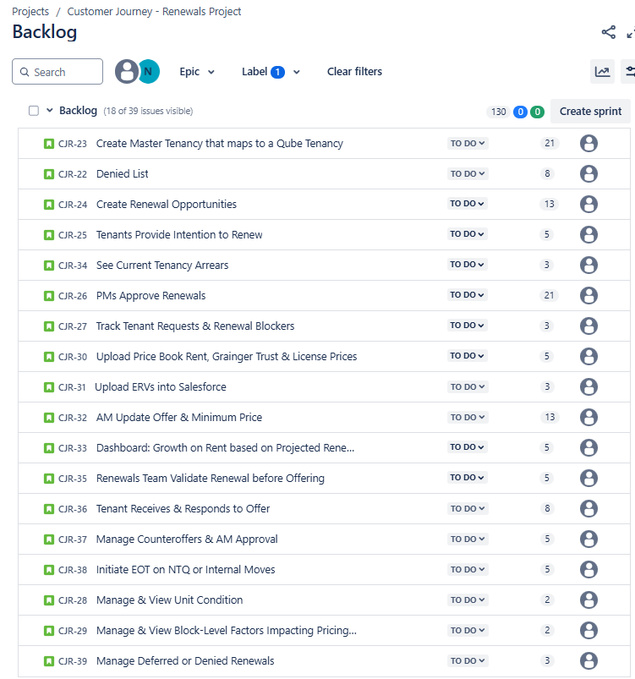
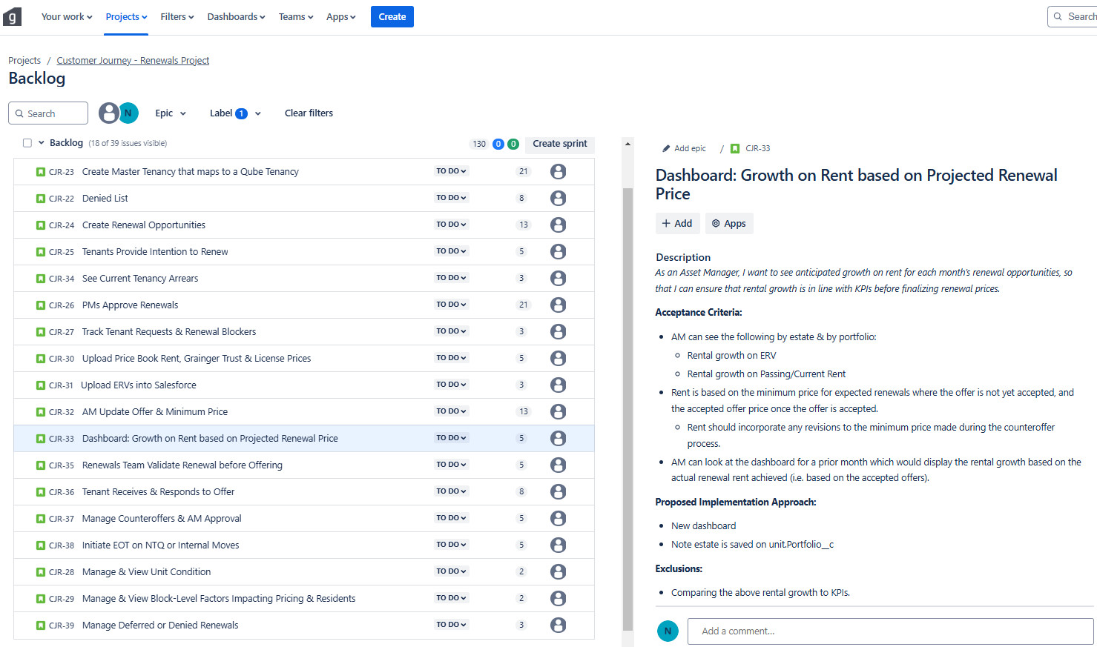
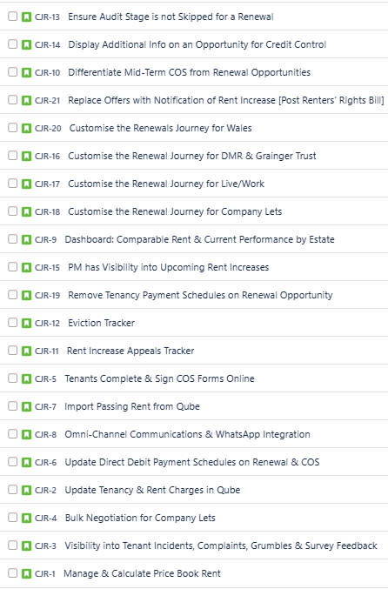
Feature Backlog
18 features addressed in Release 1 & 21 remaining features/projects

Slide 17
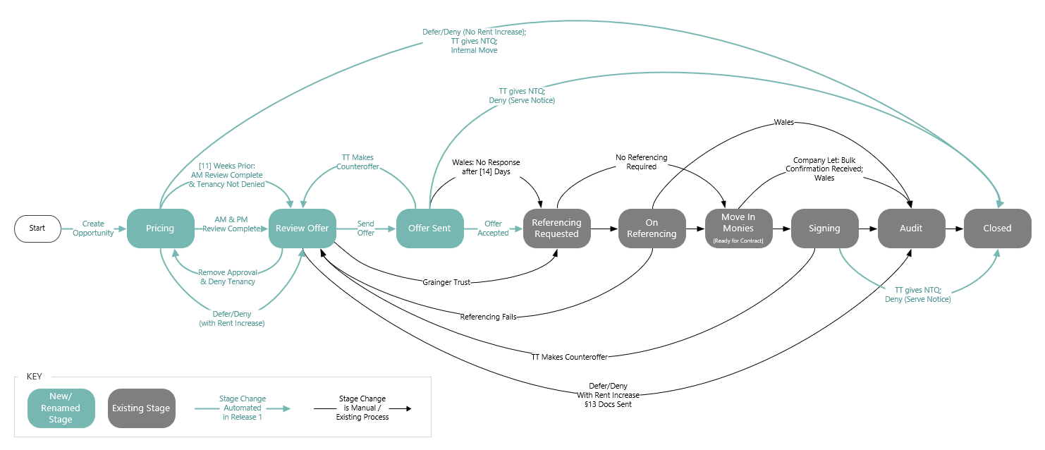
Proposed Renewal Opportunity Stages
Reimagining the Renewal Journey Up Until Offer Acceptance

Slide 18
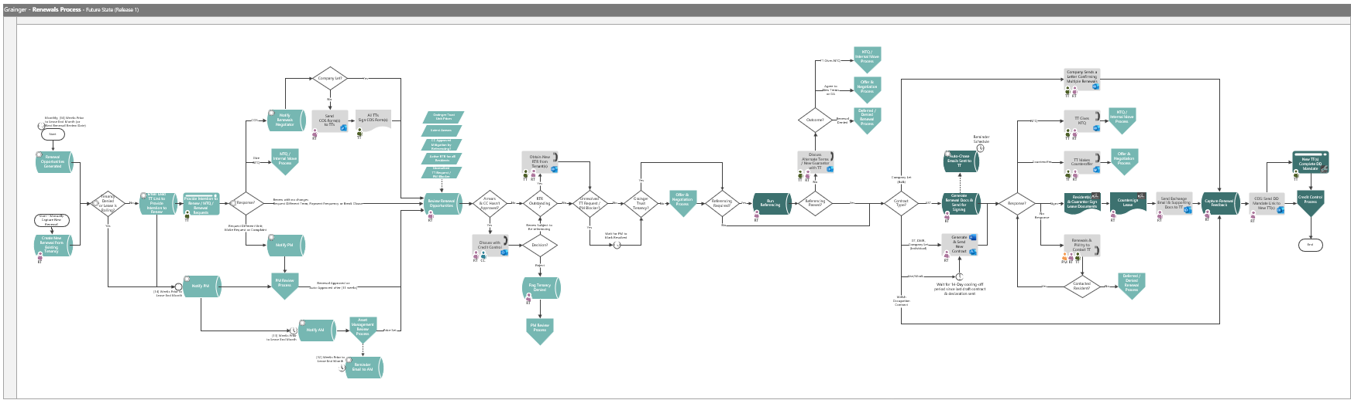
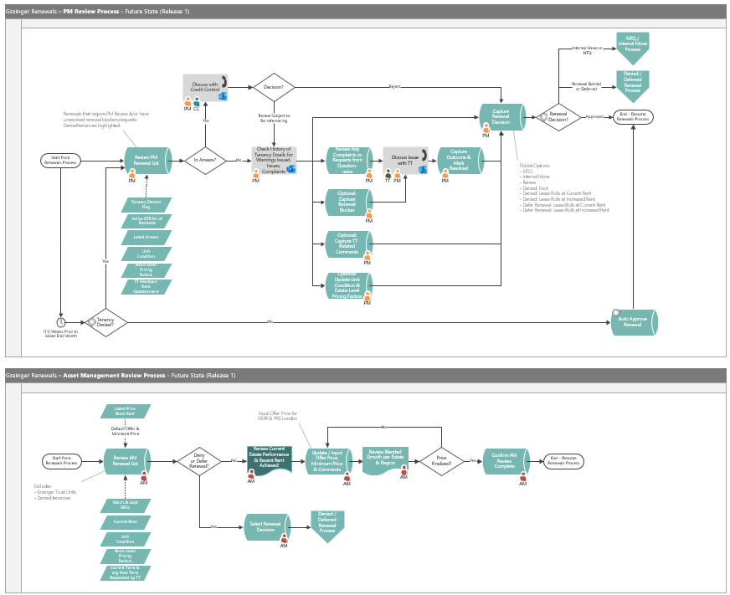
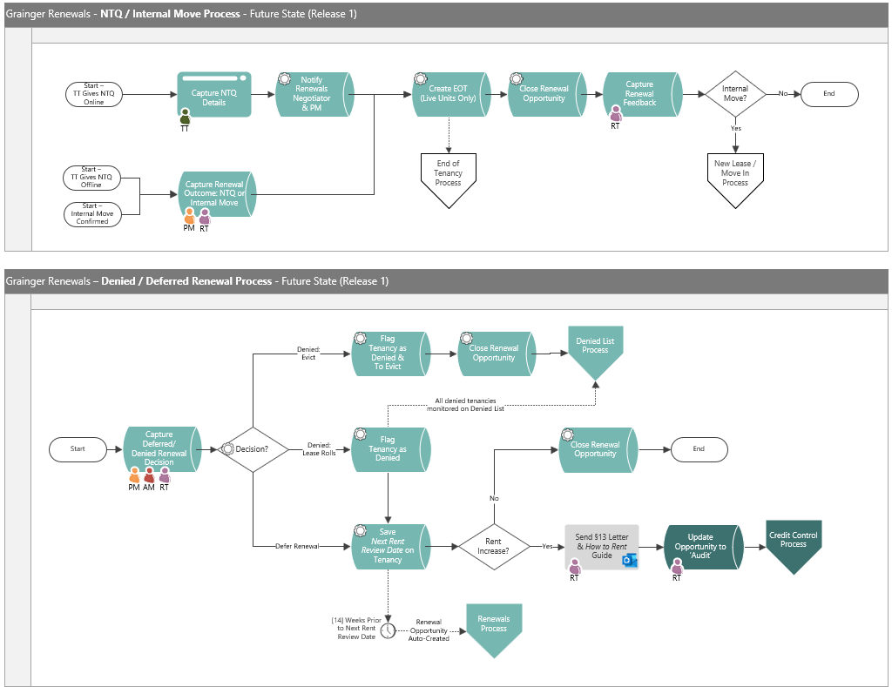
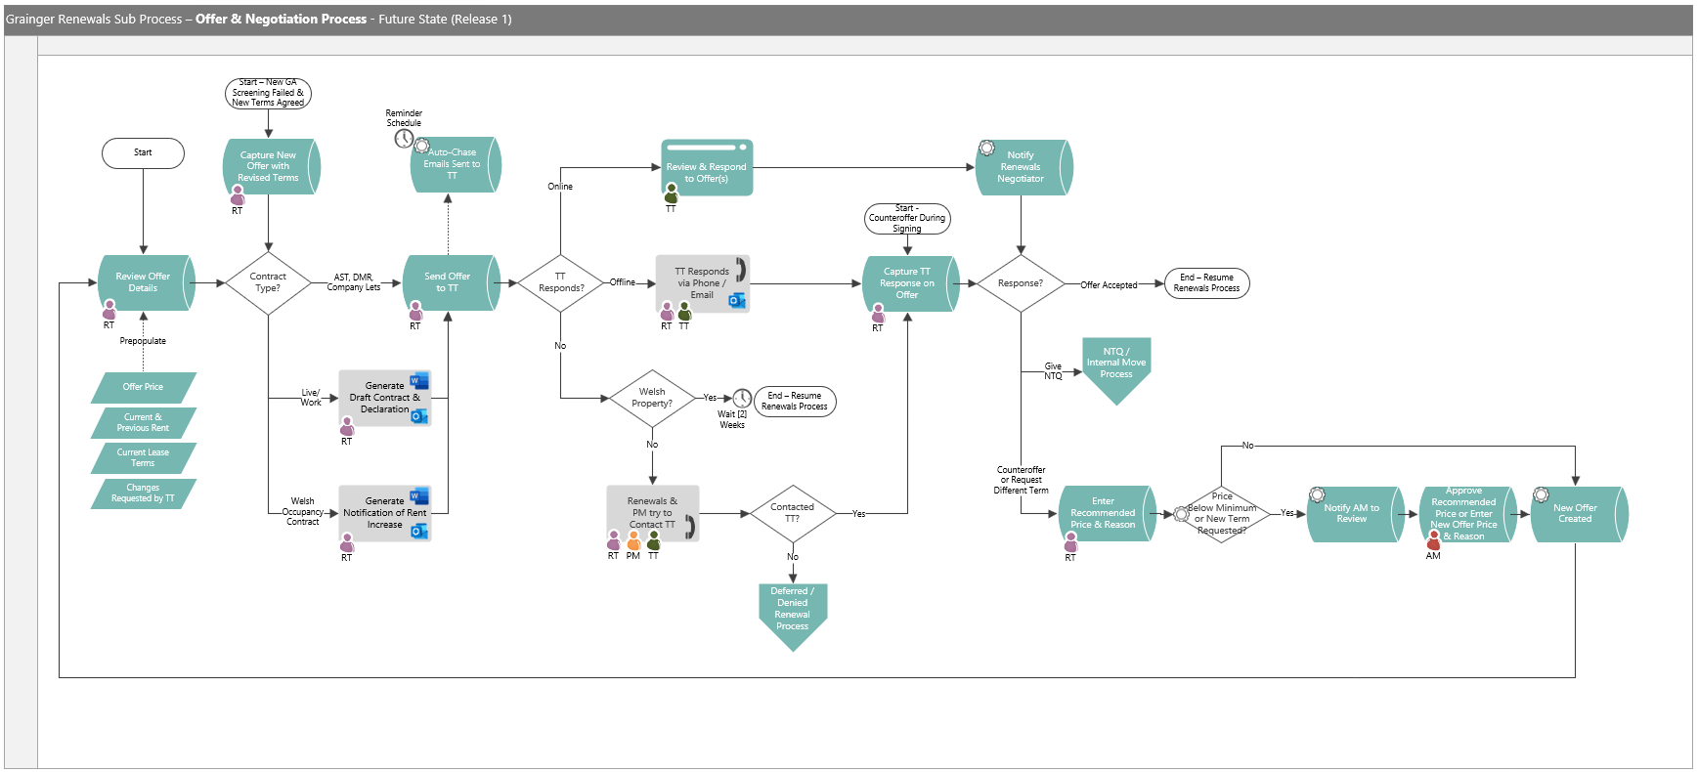
Proposed Future-State Process

Slide 19



Agile Delivery Approach
Iterative delivery is achieved through a series of 3-week sprints
Process Improvement
Sprint Retrospective
Open Box Activity
Grainger Activity
Joint Activity
Daily Stand-up
3-week Sprint
Sprint Planning
Sprint Demo
Testing
Product Increment
Sprint Backlog
Product Backlog
Backlog Refinement & Prioritisation
Backlog Refinement
Feedback

Slide 20
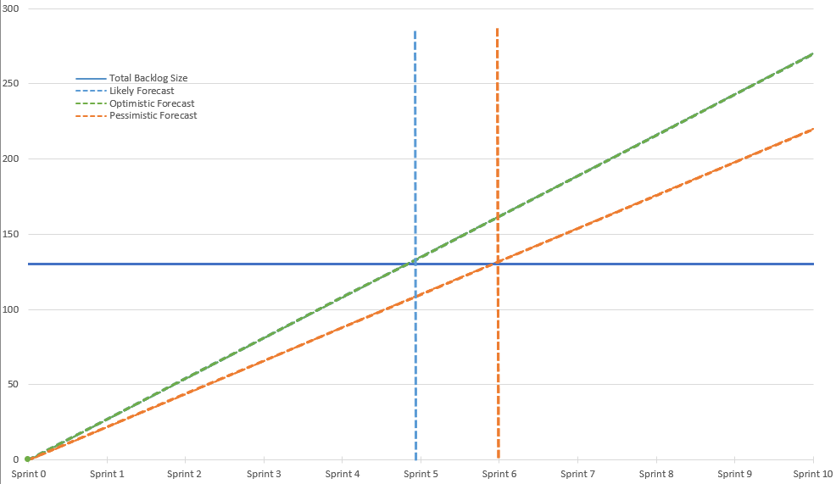
Release 1 Forecast
Likely: 4 – 5 sprints = 12 – 15 weeks

Slide 21




Project Team & Forecasted Costs
Open Box Delivery Team
Salesforce Architect
Business Analyst
Developers
Quality Assurance
Project Manager
1 Month
Release 1
5-6 sprints
560
effort
hours / month
GRAINGER Delivery Team
6 months
Product Owner - Main point of contact
£40 950
duration
sprint cost
£219,000 – £257,000
Subject Matter Experts Project Sponsor - Involved in Demos & UAT
Change Management & End User Training Specialist
total cost

Slide 22
Dependencies
The project to activate & end tenancies (as identified during the Right-to-Rent project).
Grainger adding daily integration to import tenancy arrears from the data warehouse into Salesforce.
Imports from Qube would be additionally dependent on MRI enhancing the Qube web service.
Identify DMR and affordable rent units (currently included in the Grainger Trust project).

Slide 23
Next Steps
Grainger to confirm they would like to move forward
Open Box to deliver a detailed Proposal Document for a 3-month engagement to deliver the first release of Renewals enhancements.

Slide 24

Thank You

Slide 25







































Exceptional talent dedicated to improving business operations
Risk of Monetary Loss
Time-Consuming Tasks
Risk of Errors from Significant Manual Data Entry
Risk of Renewing Tenancies that should be Denied
Lack of Visibility & Easily Accessible Information
Limited Controls

